Slide 1
My Account and Contact Information
Topics Covered in This Course:
Information Available on My Partner Account
Chatter Overview and Guidelines
Locating My Contact Information
Locating My Certifications
Notes:
Course Title:
Understanding the Partner Account Record and Using Chatter
Course Description:
The Partner Account record is the central source of information and access for much of what Salesforce has to offer. Learn information is available and how to navigate to and use it in this training. Included are partner opportunities, contacts, certifications (of employees and the firm), requests that can be made to Intel Security (such as missed benefit claims), and more. Additionally, the use of Chatter is covered, including practical guidance on when to use, and to avoid using, this social media capability built into Salesforce.

Slide 2
Learning Objectives
At the end of this course, you will be able to:
Recall how to locate your Partner Account
Recall what information is available on your Partner Account
Recall how to locate your Partner Contact
Recall where to locate your certification information on your Partner Contact
Explain where and what to Chatter on your Partner Account and Contact

Slide 3
Information Available on Your Partner Account
 | Account Detail | Contains basic Account information, like address, phone, and fax, based on information provided in the Become a Partner form. Additionally, the Partner Account contains Program Level & Specializations Details.
 | Opportunities | The Opportunities related list displays all Opportunity records the Partner has access to. Opportunities tracks information related to an end customer deal and contains a “Partner Deal Amount” field. This is an approximate amount field to assist the Partner in sizing the deal.
 | Associated Partner | The Associated Partner related list on the Partner Account displays all Associated Partner records the Partner has access to. The Associated Partner record provides partner visibility to an Opportunity and indicates program benefit s, where applicable. Partners will go here to provide their perspective of the Opportunity progress, view deal registration approval history, and submit a missed benefit claim, if needed.
 | Contacts | The Contacts related list displays Contacts (people) related to the Partner Account. Contact records hold information about certification status and system access. Contacts can have designations such as “Deal Reg Approver” or “Partner Administrator,” among others.
 | Requests | This related list allows you to view Requests submitted to Intel Security on behalf of your Account. These can include a missed benefit claim, a specialization application ,or an account modification request.
 | Open Activities / Activity History | Open Activities displays in-progress Tasks. New Tasks are also created from here. Tasks are generally used to log recent activity, such as a product demo or training. Activity History displays completed Tasks.
Partner User View

Slide 4
Information Available on Your Contact Record
 | Contact Detail | Contact records contain basic contact information, such as business email, phone, address, job title, job level, and designations. Partner users can request updates to this information through their Partner Administrator.
 | Open Activities and Activity History | Open Activities displays in-progress Tasks. New Tasks are also created from here. Tasks are generally used to log recent activity, such as a product demo or training. Activity History displays completed Tasks.
 | Partner Certifications | Displays Contact’s completed certifications.
 | System Access and Permissions | This area defines what systems the Contact has access to. System access is defined by the Partner Administrator or when user submits a Request Access form.
Partner
Contact

Slide 5
Chatter Overview
Chatter is a social collaboration tool built into Salesforce.
Chatter Term | Definition
Feed | Allows you to view what you and others have posted. You can choose to show/hide feed anywhere with a Chatter feed.
Following | Subscribing to receive notifications when there are updates to a record’s Chatter feed.
Post | What you post in your Chatter Feed to share with your colleagues and Intel Security users. Be aware that Chatter is viewable to all users with visibility to the associated record—in some cases, other partners.
@ Mention | A way to bring a post to a colleague’s attention, or mention them in a post, such as @SallySmith This features works with any Salesforce user.
#Topics (Hashtags) | A way to categorize your updates. It allows you to associate posts and comments with similar ones, such as #PartnerFocus.

Slide 6
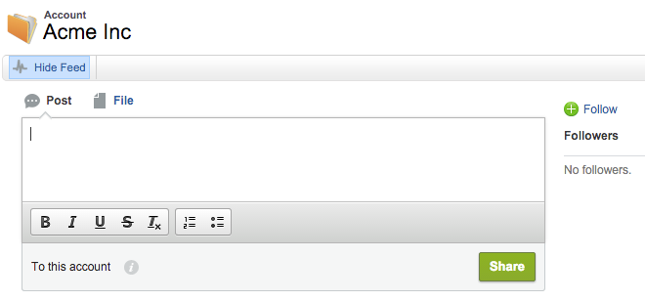
Chattering on My Account or Contact
Chatter is a social collaboration tool built into Salesforce.
Chatter is useful for posting updates or asking quick questions
For example, “@MyPartnerAdmin please add the new Boston site so it appears in the Partner Locator”
“Follow” your Account to automatically see updates posted by any user
Posting Tips
Use @mention to a specific person to alert them to the post (@SallySmith)
Use #topic to tag specific topics (#PartnerFocus)
@SallySmith I will be coming to your site next Tuesday to conduct a #training. Looking forward to seeing you!
Chatter is visible to all users with access to the record
Chatter should not be used for posting confidential or competitively sensitive information

Slide 7
Recommended Chatter Guidelines
Do...
Do participate by asking questions and sharing information
Do keep your posts relevant to work
Do keep it brief
Do use Chatter to address a wider audience, where applicable
Do post files
Be mindful that other partners may be able to see what you post on the Opportunity record
Don’t...
Don’t post anything you wouldn’t want on the front page of the New York Times
Don’t write long-winded posts
Don’t use Chatter to replace an in-person conversation
Don’t post confidential or competitively sensitive information
Don’t post personal messages that aren’t relevant to business

Slide 8
Demonstration
Navigate Account
Chatter on Account
Navigate Contact

